Slide 1
"Data modeling is where art meets science. It requires the precision of a mathematician, the creativity of an artist, and the judgment of an experienced craftsman to transform raw data into valuable insights.“
Gepetto di Firenze

Slide 2
Steps
Understanding the data
Converting the covariates to pseudoobservations
Calculating the sum of them and after eliminating the correlation effect (method applied 1 by 1 until all covariates become one)
Created a lag variable to help the model understand when it’s the crisis is over

Slide 3
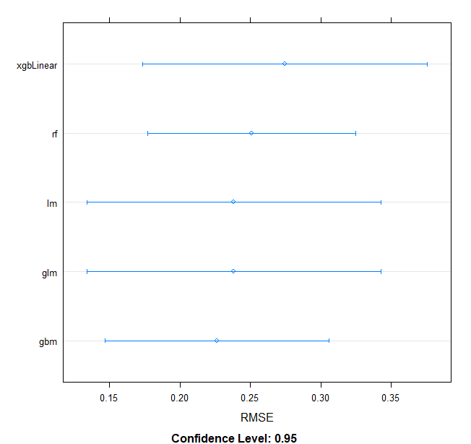
Modeling
5 models were tested:
GBM
LM
Random Forest
XGBoost
GLM

Slide 4
Next step
Out of the 5 models observed, it was built an ensemble of them all having an optimisation function that applies different weights in order to get a better RMSE for the ensemble built

Slide 5
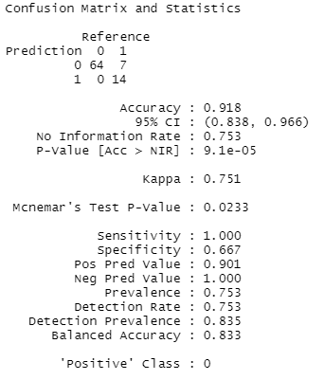
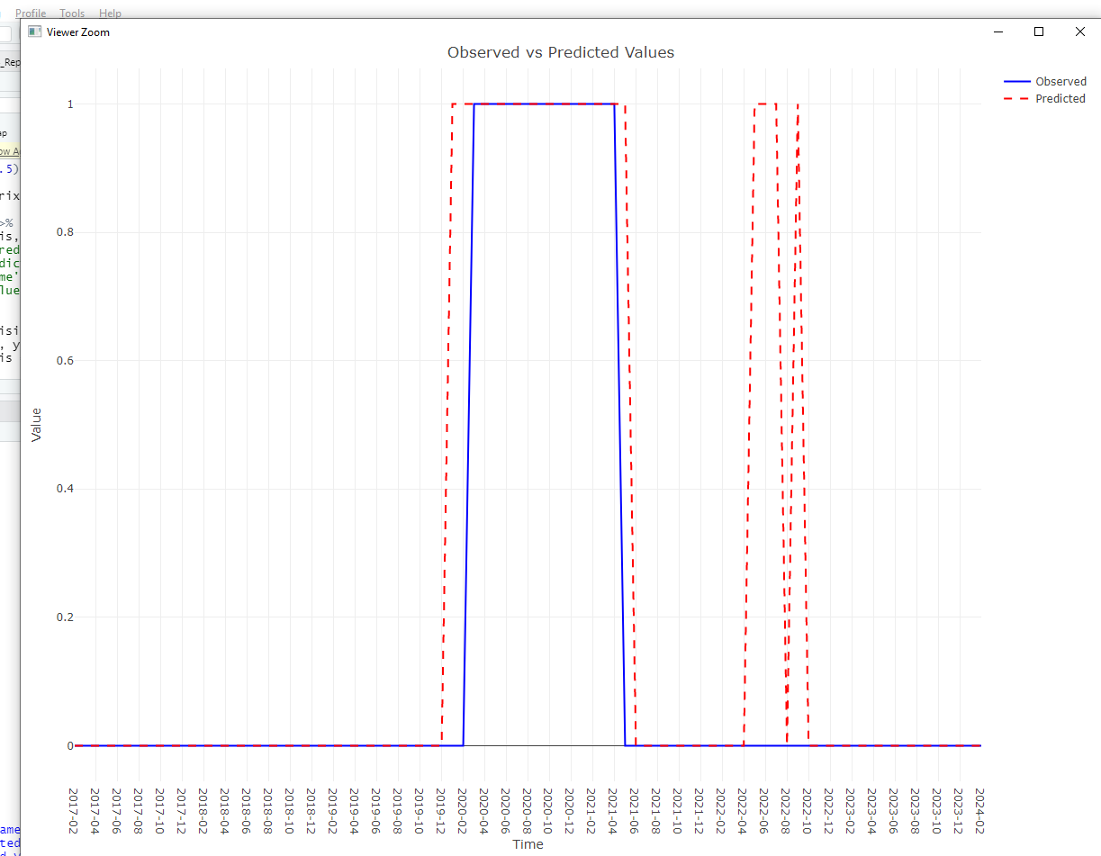
Testing showed that the model was able to anticipate the crisis 3 months before (Covid period) and was also able to capture the geopolitical impact in comparison to the target variable

Slide 6
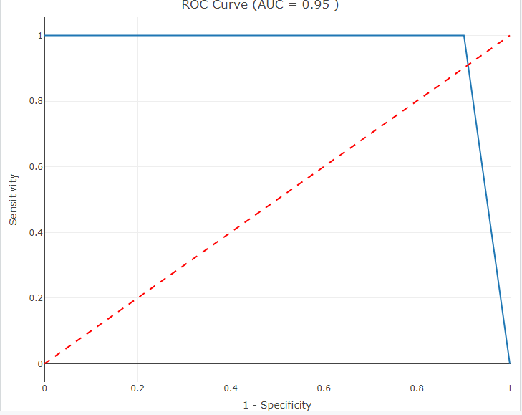
AUC
In general, an AUC of 0.5 suggests no discrimination (i.e., ability to diagnose patients with and without the disease or condition based on the test), 0.7 to 0.8 is considered acceptable, 0.8 to 0.9 is considered excellent, and more than 0.9 is considered outstanding.

